Slide 1
Software Engineering Studio 3 Product Assessment
FRIENDS
Graphics created by Ullupta conecum re volupta evelignis pe et doluptuam.

Slide 2
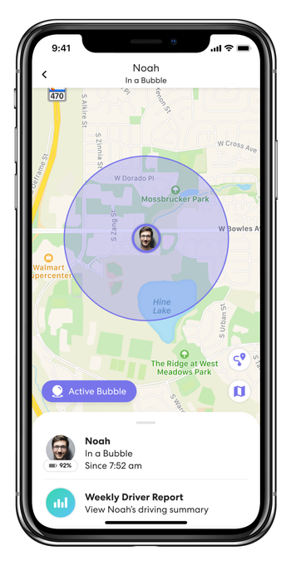
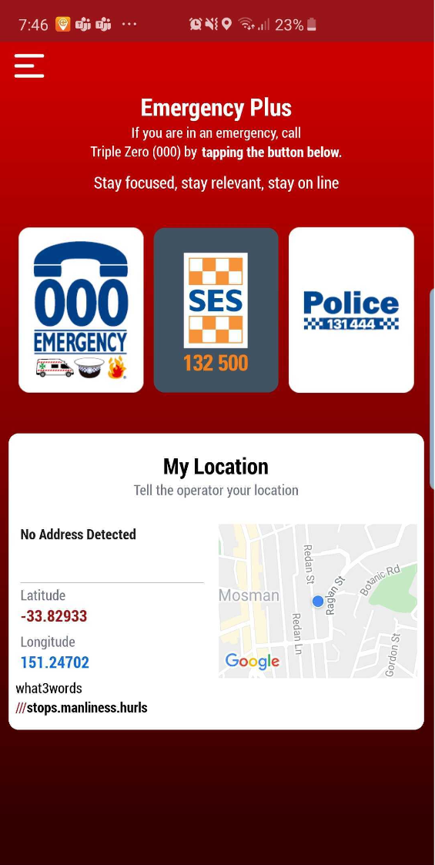
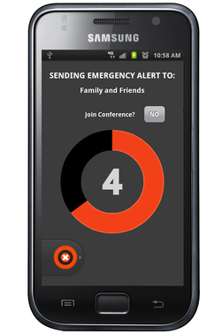
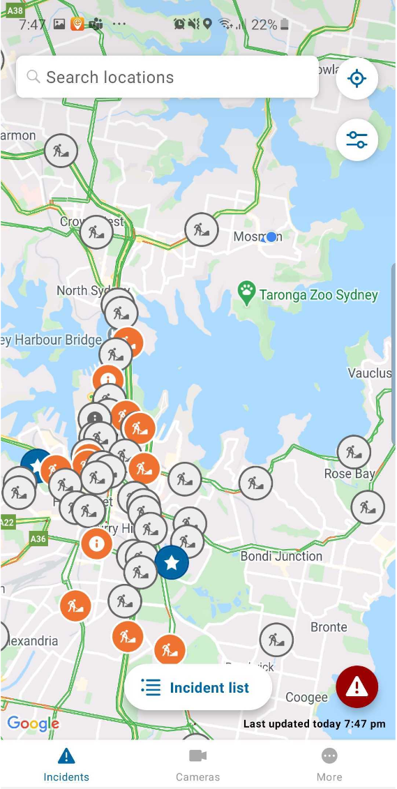
The Problem
People have a huge AMOUNT and VARIETY of risks they can be exposed to
How should they approach these? What is best?
Currently no centralised solution
LIFE360
EMERGENCY PLUS
GAURDLY
LIVE TRAFFIC NSW

Slide 3

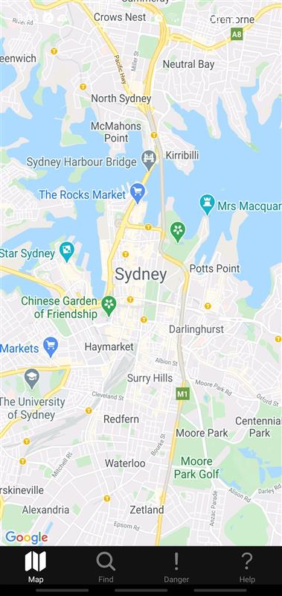
The Solution: FRIENDS
For
Rescue
In
Emergency
aNd
Daily
Situations
Notes:
FRIENDS is a scalable, secure and intuitive system which centralises the existing approaches taken to help civilians minimise their risk in their everyday lives.

Slide 4
Key Users and their Needs
CIVILIANS
Avoid dangers relative to themselves
Communicate with authorities
Be able to quickly receive help at their location
Be informed of what to do in a crisis
Bottom Line: Be Protected
AUTHORITIES
Inform Civilians of dangers
Reassure civilians in danger
Be able to reach at risk civilians quickly
Be able to track resources and events in a crisis
Bottom Line: Protect Others

Slide 5
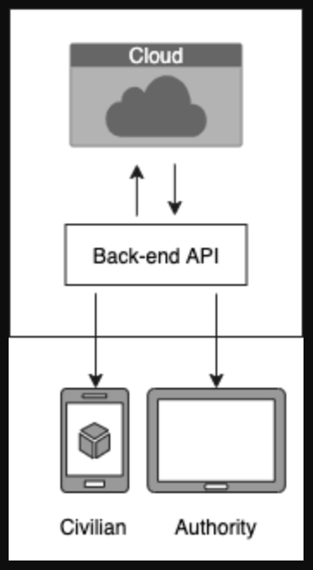
Architecture Overview
MySQL cloud storage
API built in python using Flask
React Native front-end

Slide 6
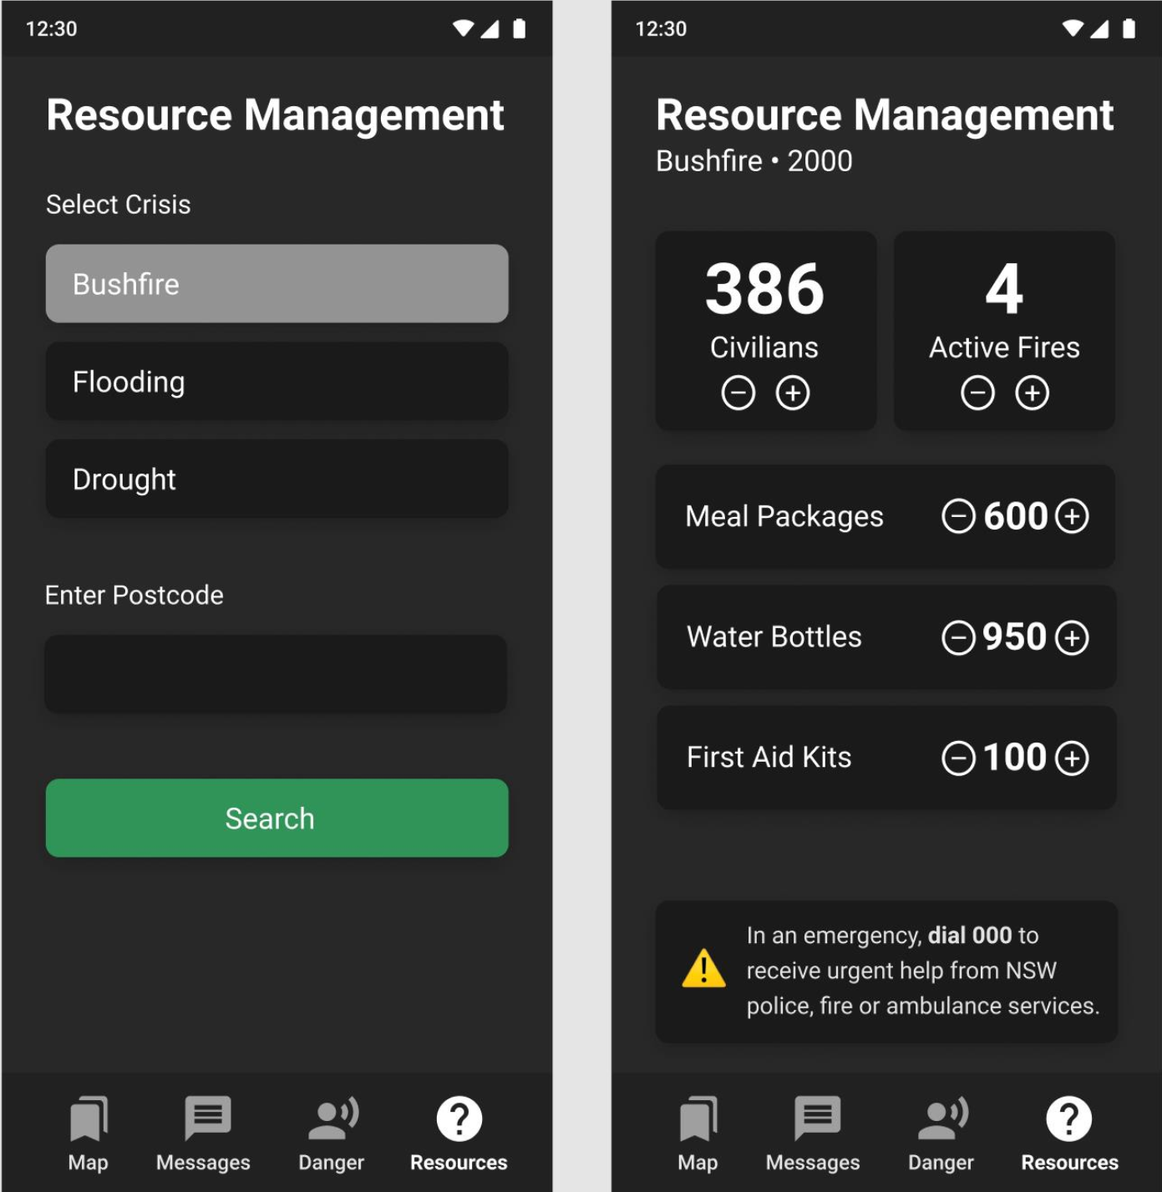
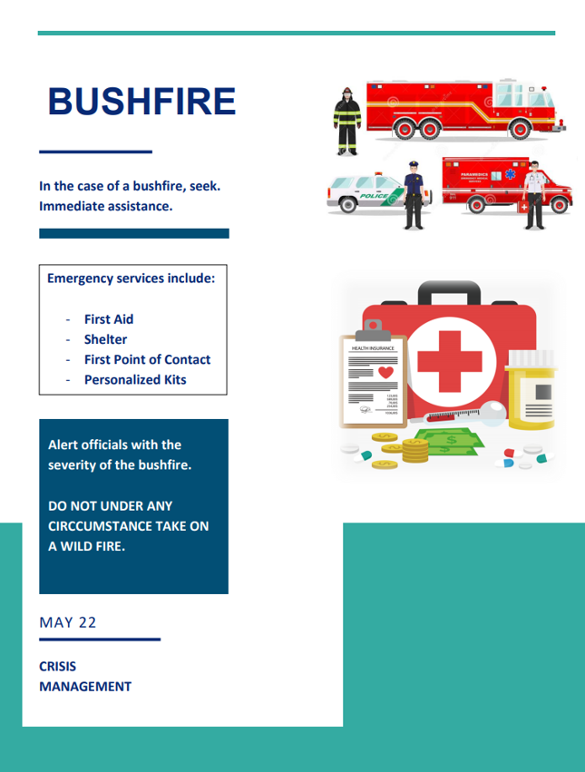
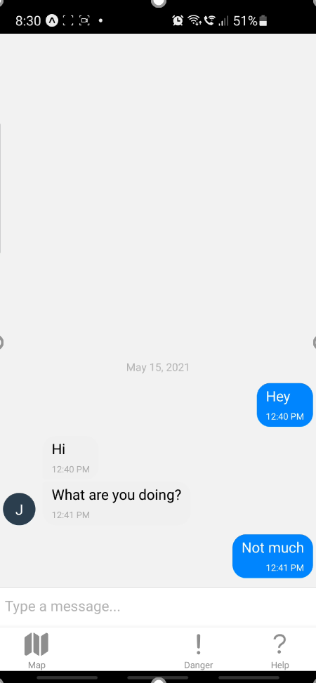
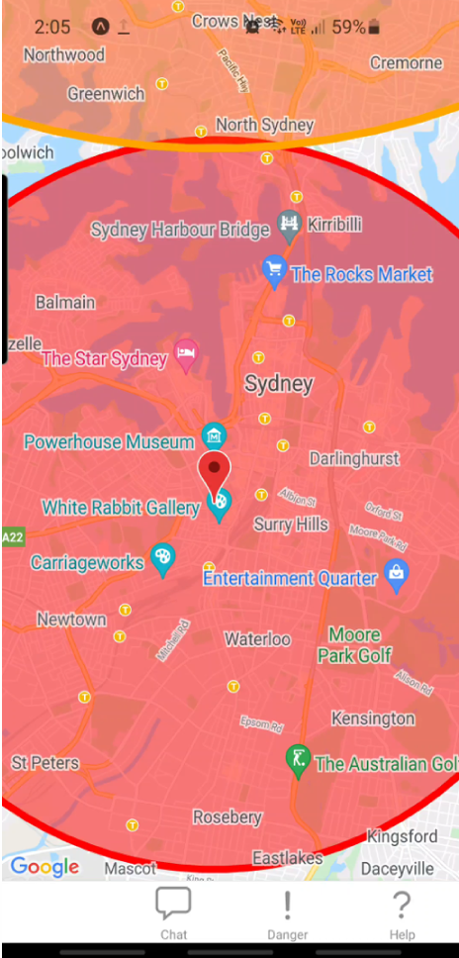
At the End of 3A
RESOURCES
HELP
MAP
COMMUNICATE

Slide 7
Going Forward in 3B

Slide 8
SETBACKS
PROBLEM
Code decay on front-end repo. Several out-of-date dependencies causing system crash.
SOLUTION
Front-end to be reworked as a React website for easier testing, access and build
REASON
React Native and Expo.Go proved to be unnecessary complex. When code decay issues arose it was determined more worth while to simply migrate the JavaScript across to an easier to manage webpage platform. Additionally, this proves the versatility of the backend API across platforms
AFFECTS
Messaging, Geolocation, Quality Assurance, legacy functions from 3A

Slide 9
3B Features
Improved Messaging
Improved Geolocation
Including user tracking
Security
Encryption using AES, JWT tokens hashed with sha256
Google Authenticator
ML Chatbot
Data gather for Event creation
Calm Down
Quality Assurance
Automated Testing
Overall Improvement

Slide 10
Improved Messaging

Slide 11
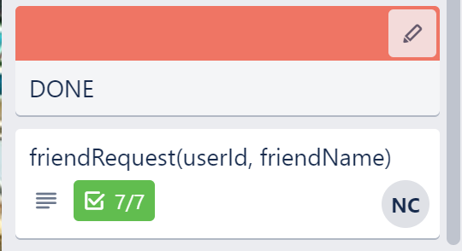
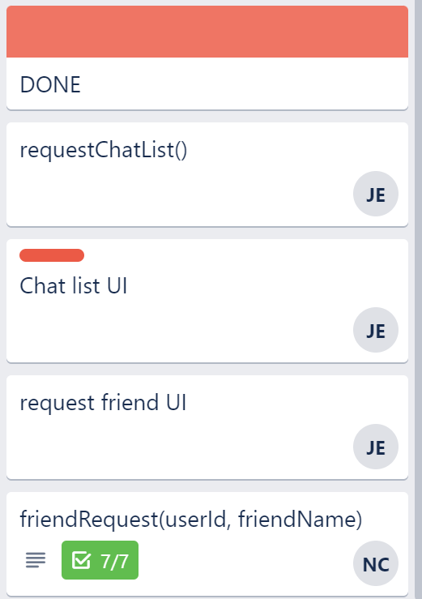
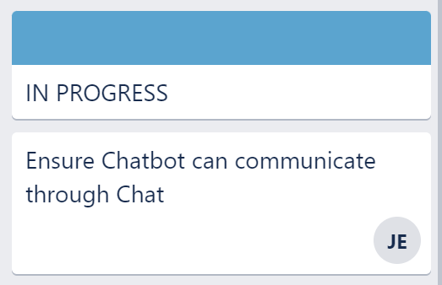
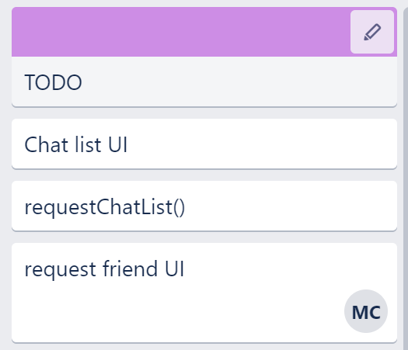
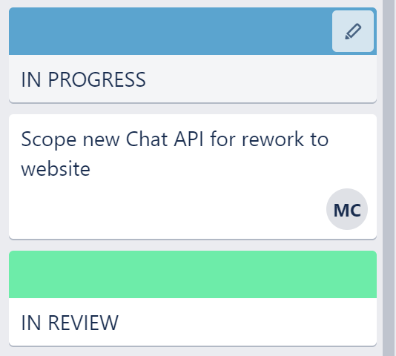
Progress
IMPROVED MESSAGING - Before
IMPROVED MESSAGING - Now

Slide 12
Demo

Slide 13
Improved Geolocation

Slide 14
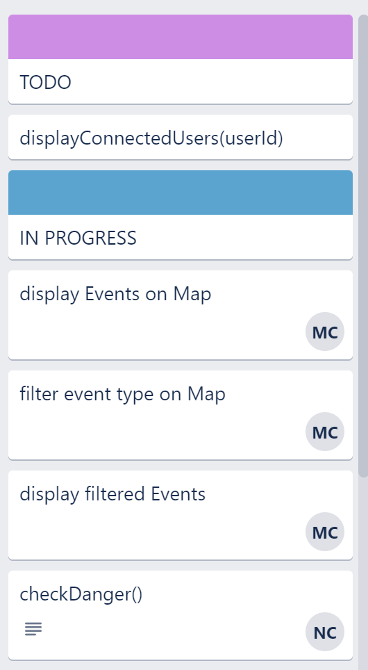
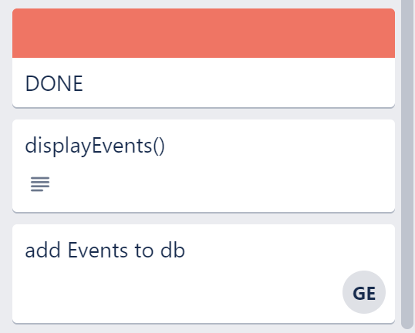
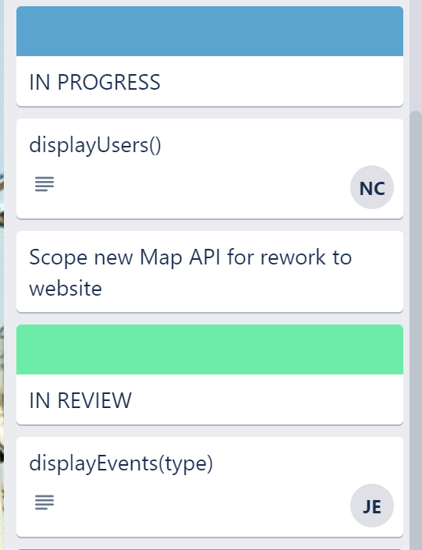
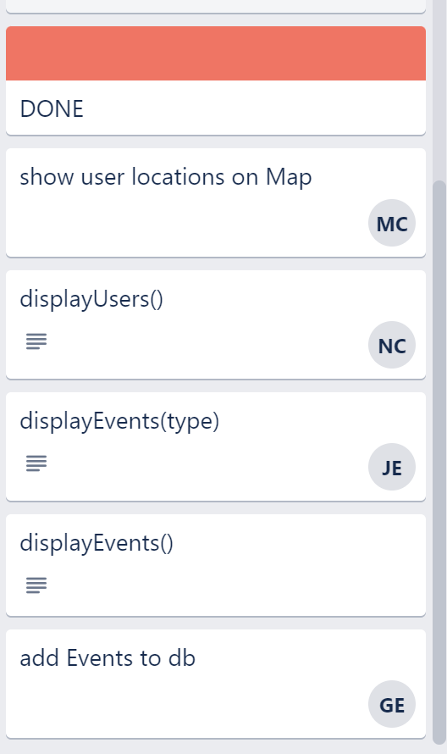
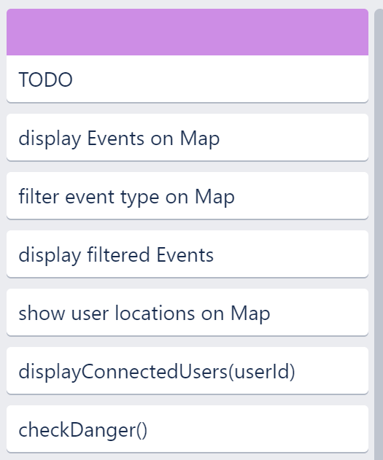
Progress
IMPROVED GEOLOCATION - Before
IMPROVED GEOLOCATION - Now

Slide 15
Demo

Slide 16
ML Chatbot

Slide 17
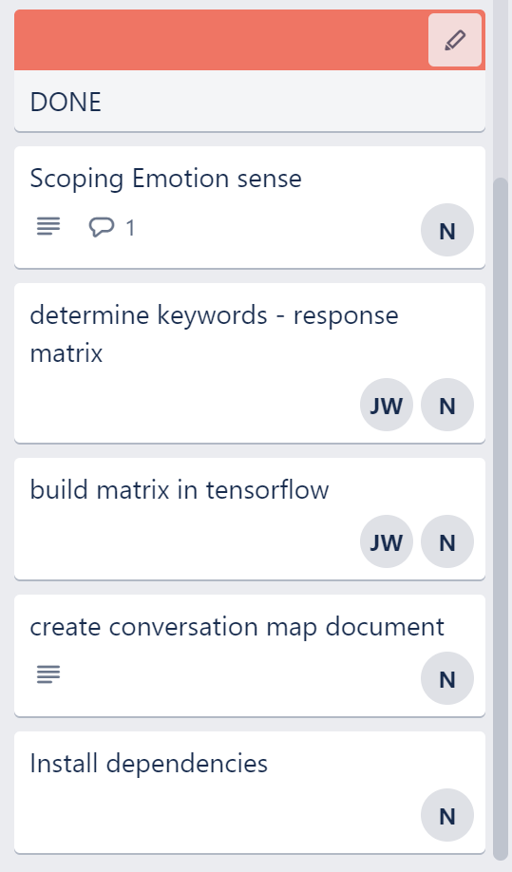
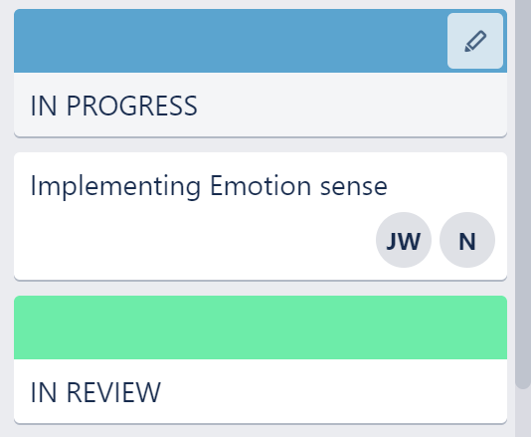
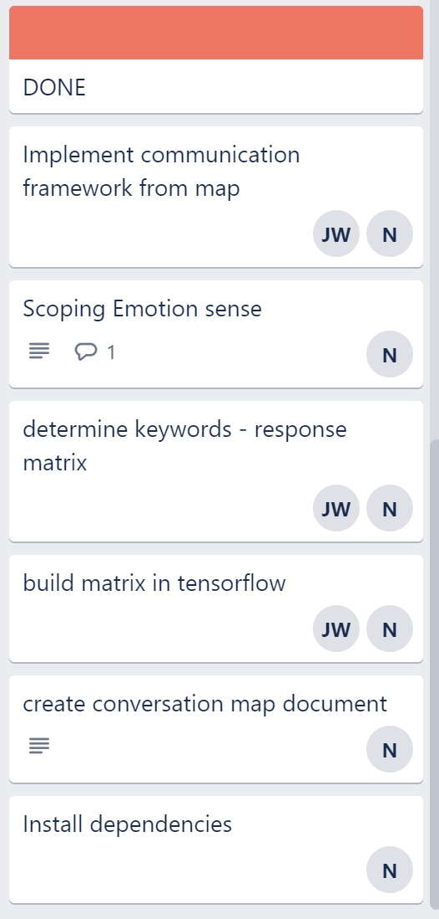
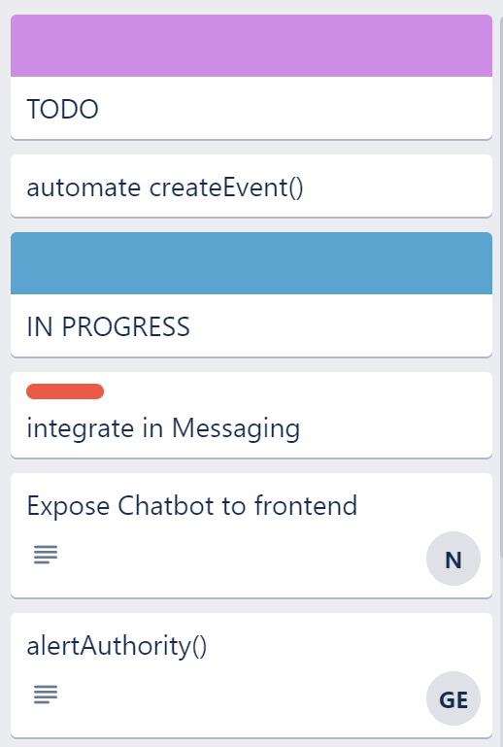
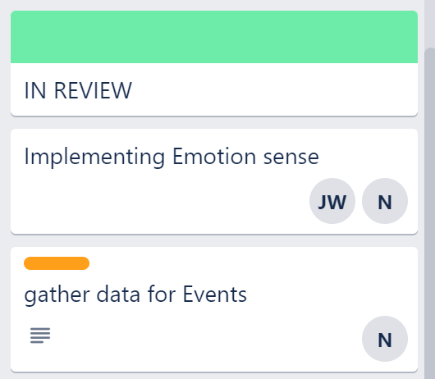
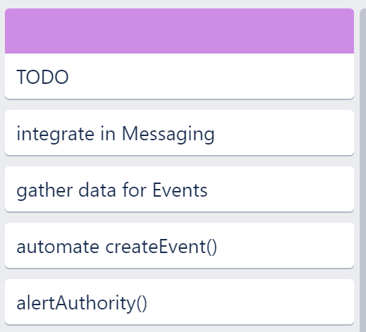
Progress
ML CHATBOT - Before
ML CHATBOT - Now

Slide 18
Demo

Slide 19
Security

Slide 20
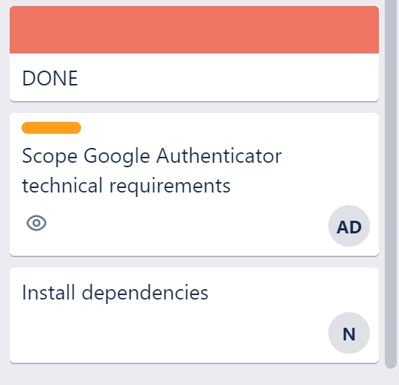
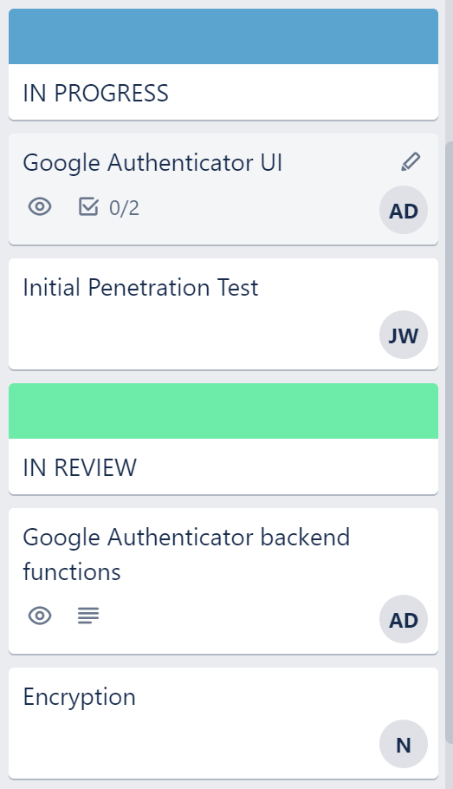
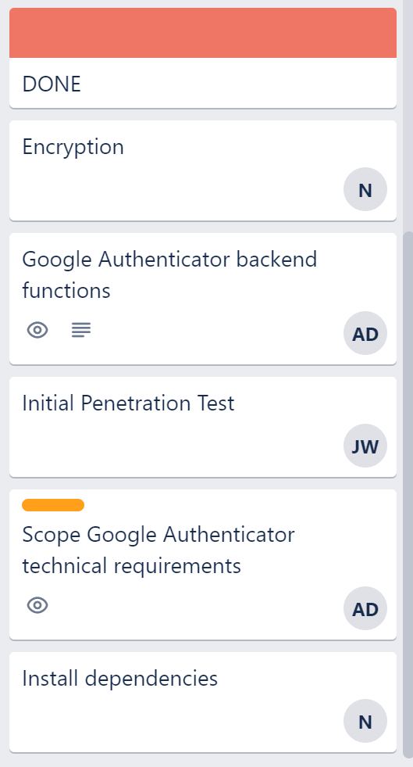
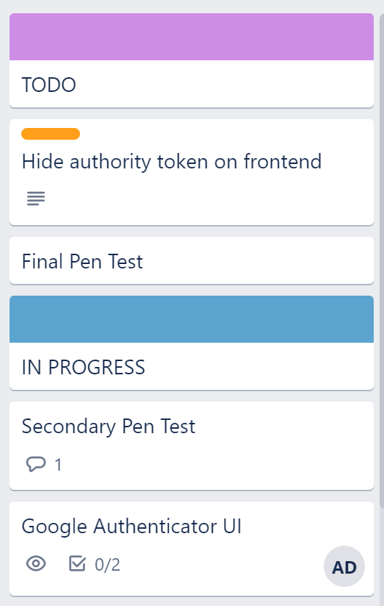
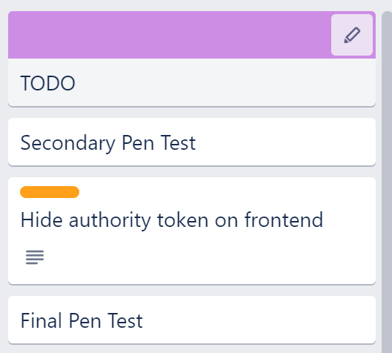
Progress
SECURITY - Before
SECURITY - Now

Slide 21
Quality Assurance

Slide 22
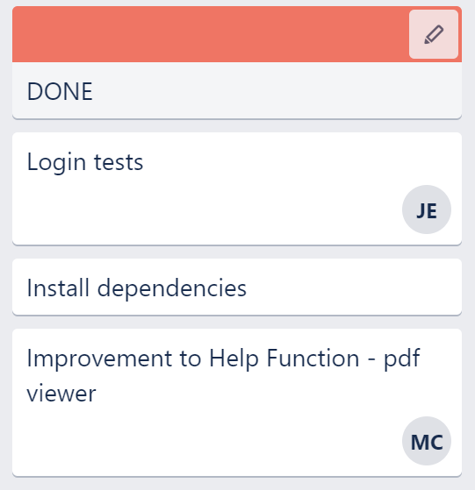
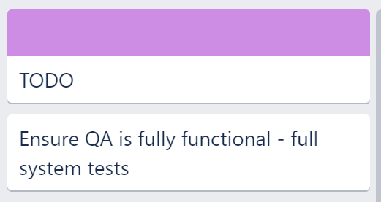
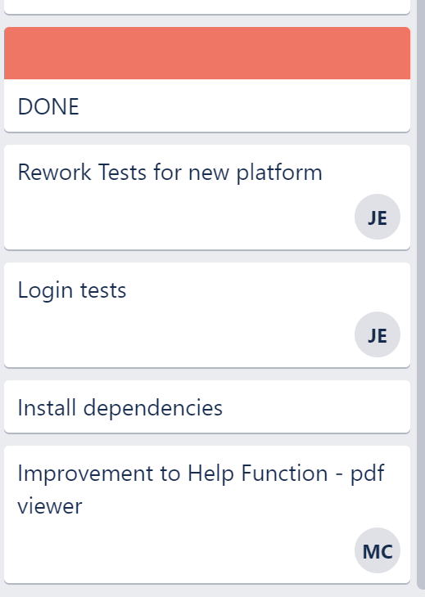
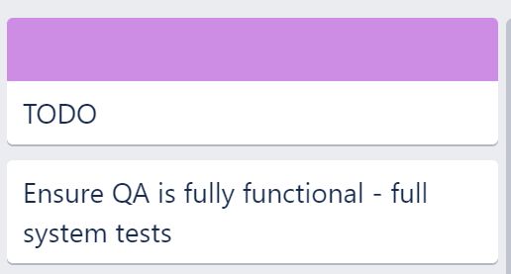
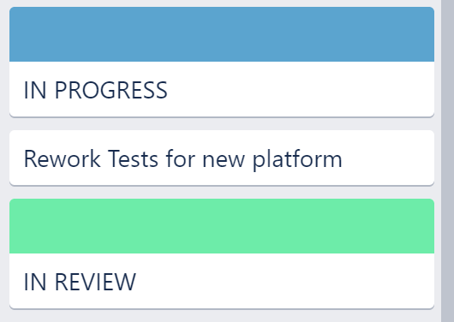
Progress
QUALITY ASSURANCE - Before
QUALITY ASSURANCE - Now

Slide 23
Going Forward

Slide 24
Final Tasks
Integrate Chatbot with the front-end Chat
Properly test Security and Quality Assurance to ensure proper implementation
Expand Map and Geolocation to display dangers
Add better control functionality using Settings and Admin controls
Transfer over remaining 3A functions from original repository

Slide 25
Thanks Q&A

